Slide 1
MIGRATING BIRD OPTIMIZATION

Slide 2
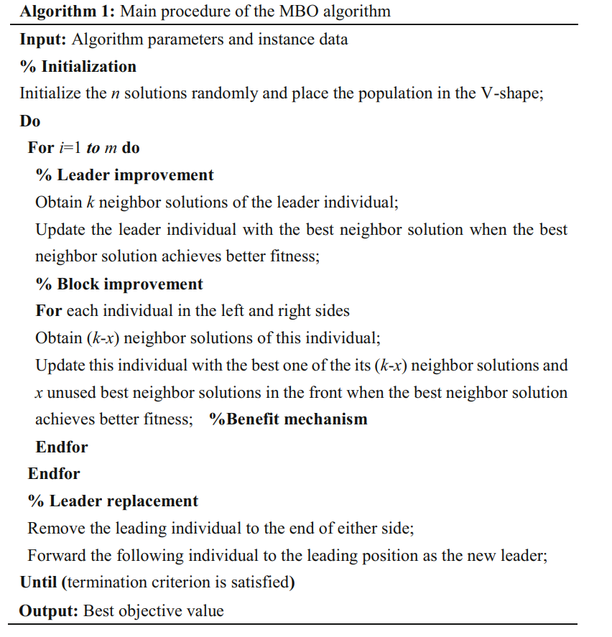
GENERAL FLOW OF MBO

Slide 3
ENCODING
A sequence of tasks(following precedence relation) is used to represent the order of tasks to be performed.
A sequence of process alternatives representing numbers between 1-3 for each station representing,
1 - Only robot is allocated
2 - COBOT (robot + human) is allocated
3 - Only human is allocated
For example, a 11 task 4 stations encoding sequences looks like,
TASK PERMUTATION - 1 3 2 4 5 8 9 6 7 10 11
PROCESS ALTERNATIVES - 1 3 2 3

Slide 4
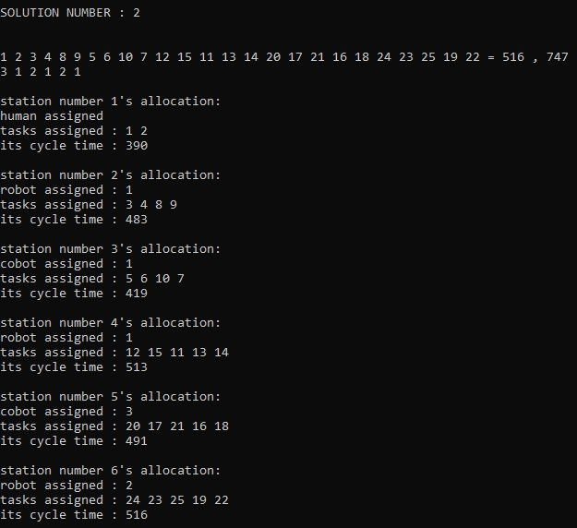
DECODING
Given a sequence of tasks and process alternatives, the allocation is found using consecutive method. For example, (25 tasks 6 stations)

Slide 5
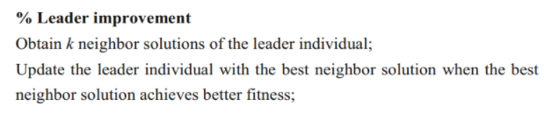
LEADER IMPROVEMENT
First the leader is found using NDS(non dominated sorting) & CD (crowding distance) - similar to PSO’S g_best.
To obtain neighbour solutions, two methods are proposed. They are,
By changing the task sequence (k/3)
By changing the process alternative sequence (k/3)
By changing both (k/3)
This k is fixed as, k = 10%-20% of the population size.

Slide 6
CHANGING THE TASK SEQUENCE
To change and find neighbor solutions of a particular solution,
First a random number ‘r’ is generated between 1-n, where n = no. of tasks
Then the tasks in position 1 - r are kept unchanged and the tasks from position r+1 - n are shuffled randomly such that precedence relation is followed. For example, (taking 5 tasks)
BEFORE CHANGING - 1 3 4 2 5
RANDOM NUMBER GENERATED ( r ) - 2
AFTER CHANGING - 1 3 2 4 5

Slide 7
CHANGING THE PROCESS ALTERNATIVE SEQUENCE
To change and find neighbor solutions of a particular solution,
SWAPPING and SINGLE POINT MUTATION (randomly picking a position and changing its value) is performed such that the constraints are satisfying. For example for a 4 station problem,
BEFORE CHANGING - 1 3 1 2
AFTER PERFORMING SWAP - 1 3 2 1 (last two positions are swapped)
AFTER SINGLE POINT MUTATIONS - 2 3 2 1 (1st position is mutated)

Slide 8
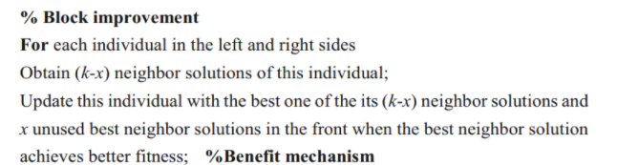
2. BLOCK IMPROVEMENT
Each individual in the left and right just means that, solutions other than g_best.
To obtain neighbour solutions, same methods as mentioned before is used. They are,
By changing the task sequence ((k-x)/3)
By changing the process alternative sequence ((k-x)/3)
By changing both ((k-x)/3)
This x here is fixed as any number less than k. Can be generated randomly or fixed.

Slide 9
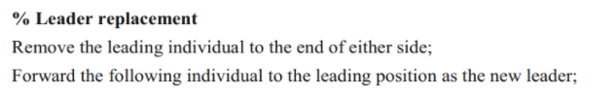
3. LEADER IMPROVEMENT → SCOUT PHASE
Instead of following the same phase here, we would like to change this as the scout phase in ABC algorithm.
This scout phase removes the retained solutions once it passes its limit (which is set by user) and replaces it with a random solution.

Slide 10
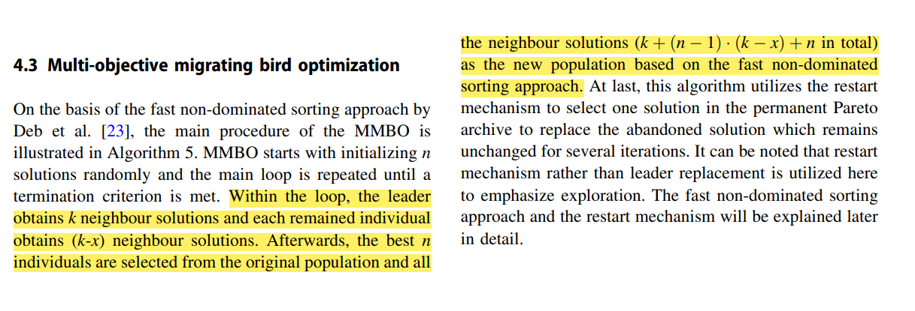
WHY THIS IS BETTER?

